Slide 1


Question Answering & Information Retrieval
UCREL Summer School. Session 2:
Dr Saad Ezzini and Damith Dola Mullage

Slide 2
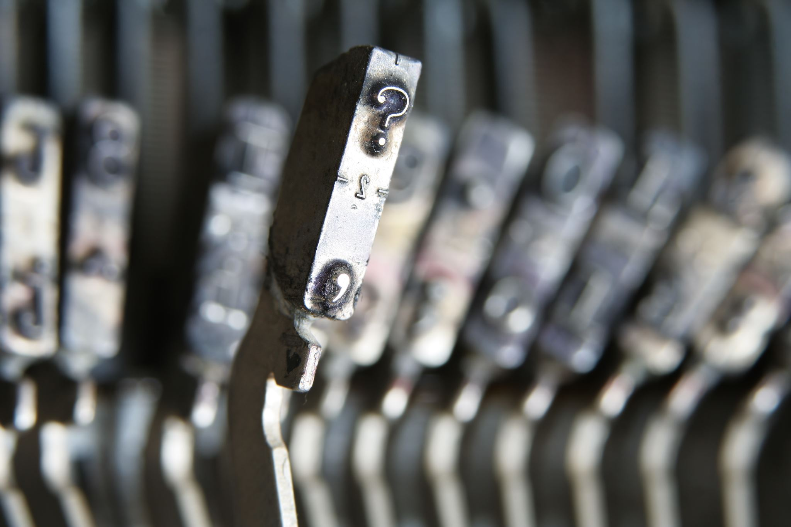
Agenda
Concept Presentation
Tutorial Walkthrough
Attendees Turn

Slide 3
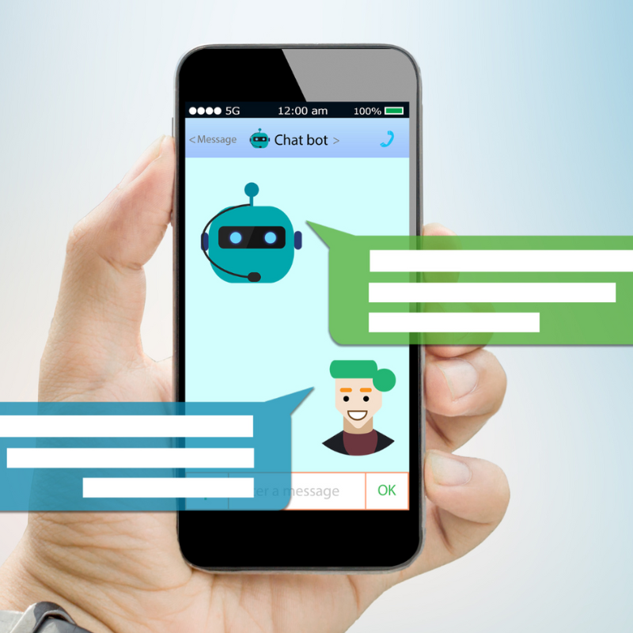
Introduction
ChatGPT
ChatBots
Banking
E-Commerce
This Photo by Unknown Author is licensed under CC BY-NC-ND

Slide 4
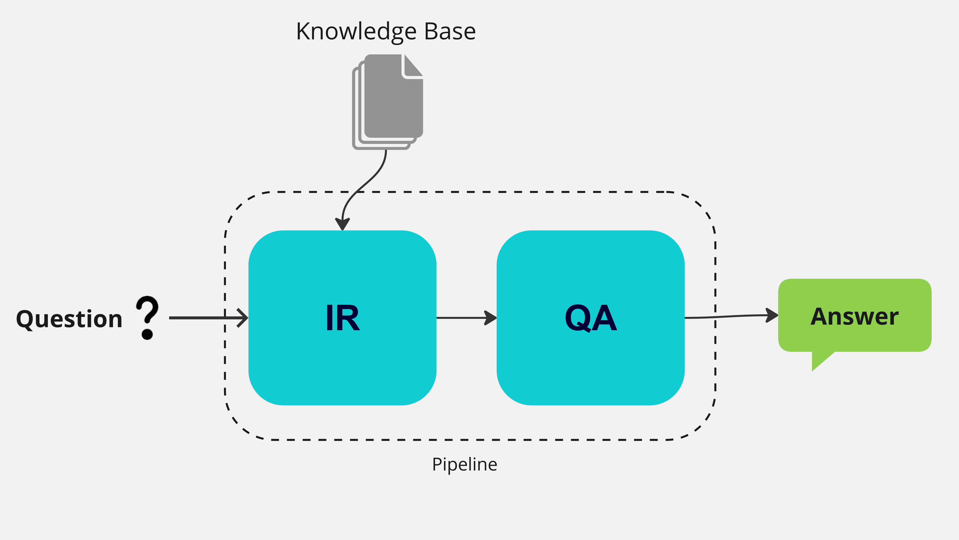
The Pipeline
Pipeline: a combination of multiple components with specific input and output
Input: a given question
Step1: IR retrieves the document that has the answer
Step2: QA uses the identified document to give the final answer.
IR: Information Retrieval
QA: Question Answering
Knowledge Base: external documents or sources that contain the answer (e.g., Wikipedia)

Slide 5
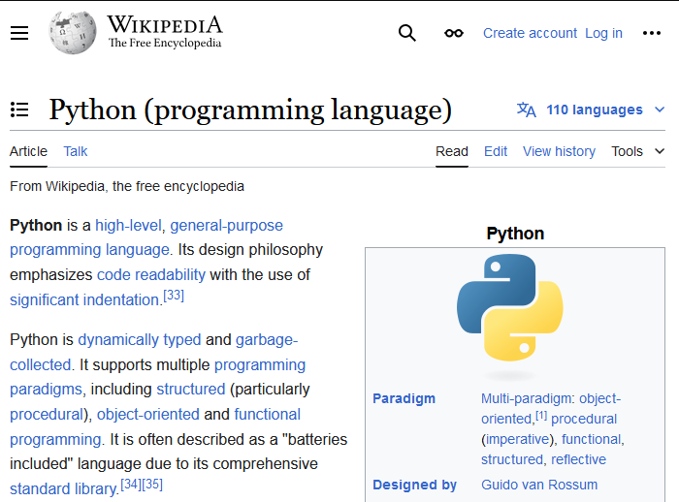
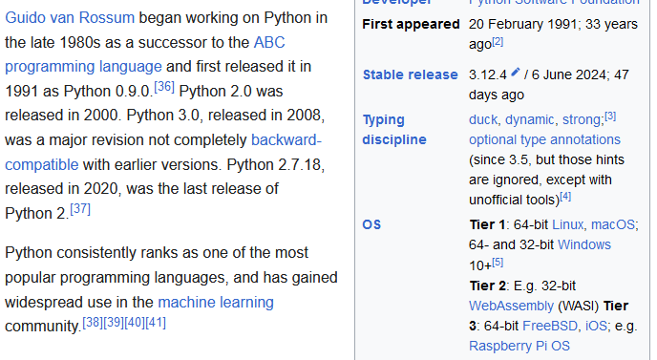
Example:
Question: Who created Python?

Slide 6
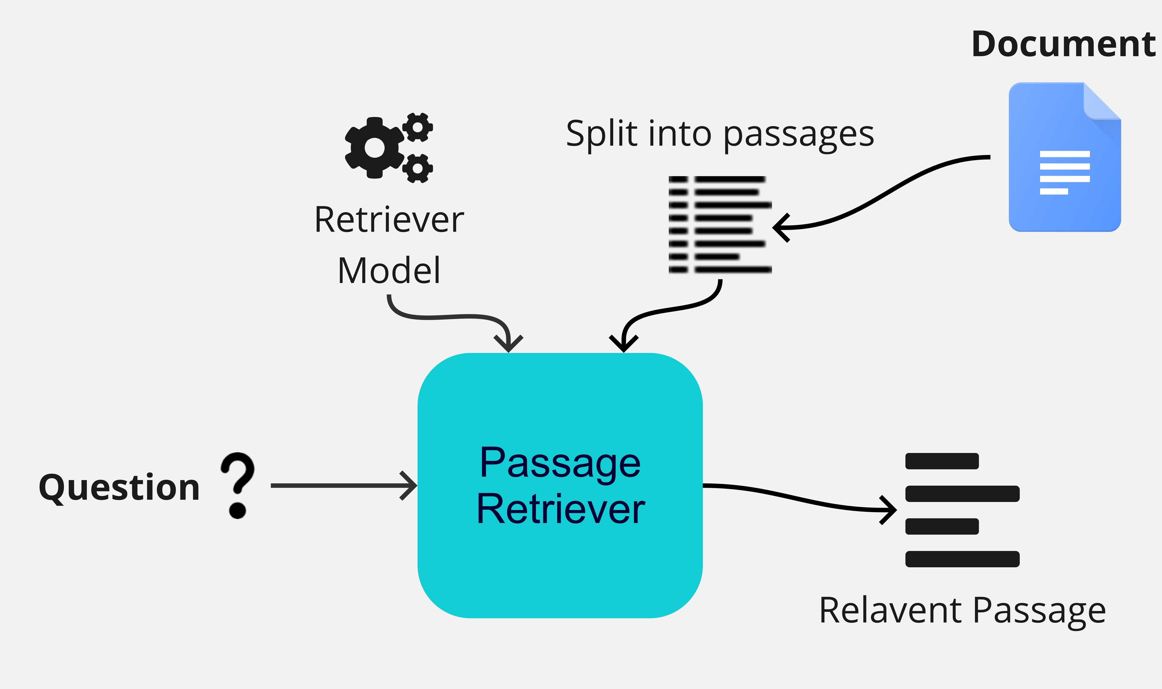
Context Retrieval (IR)

Slide 7

Process: IR

Slide 8
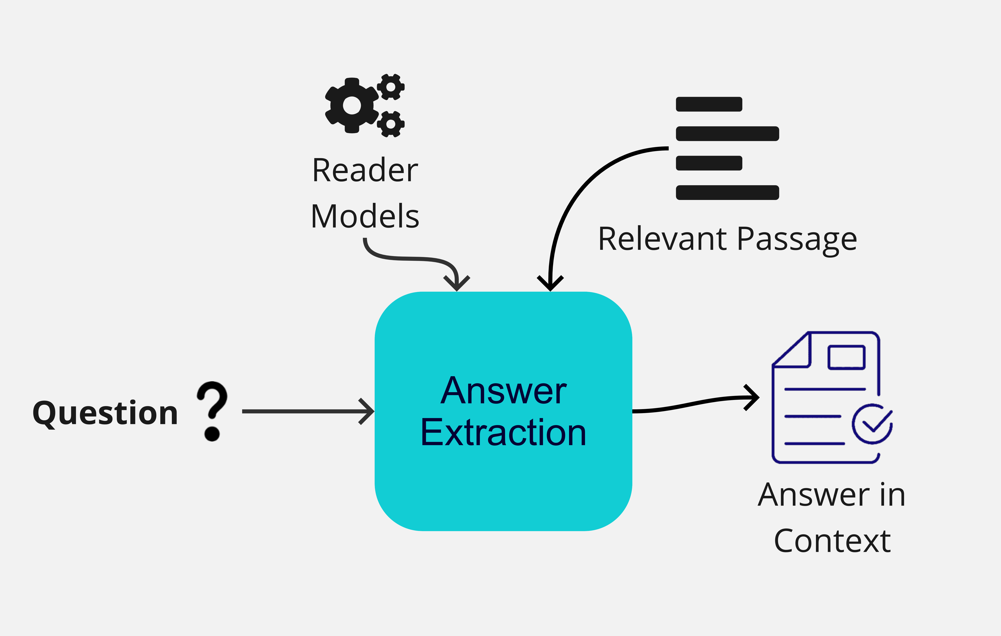
Answer Extraction (QA)

Slide 9

Process: QA

Slide 10
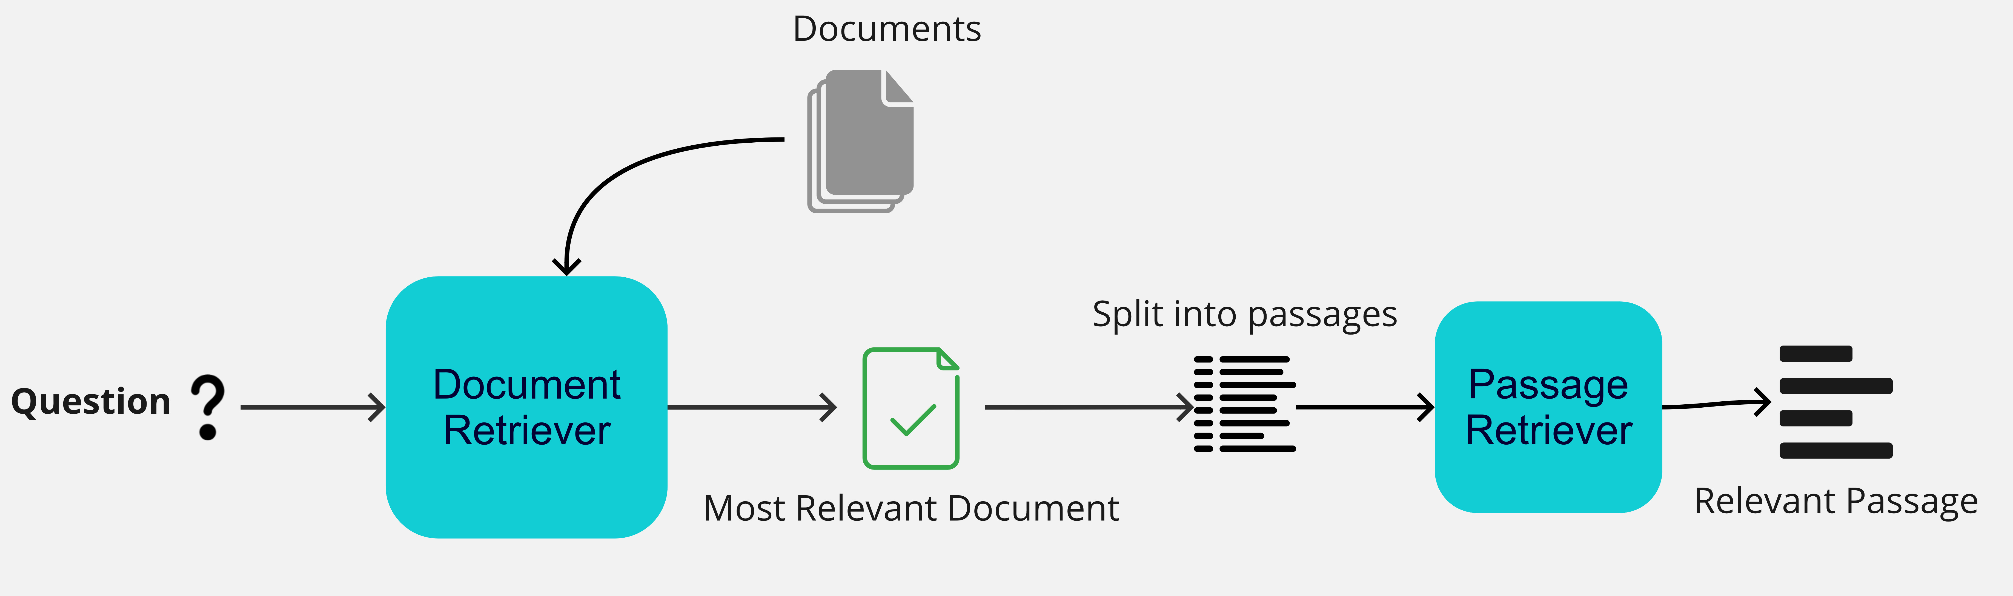
Double IR

Slide 11
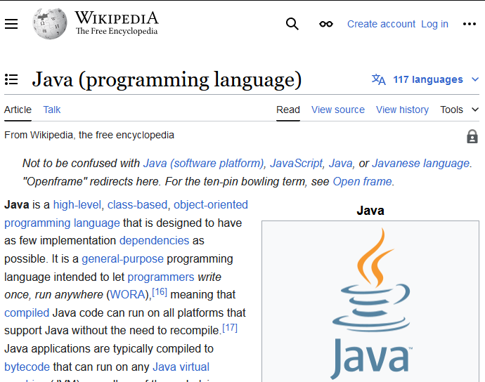
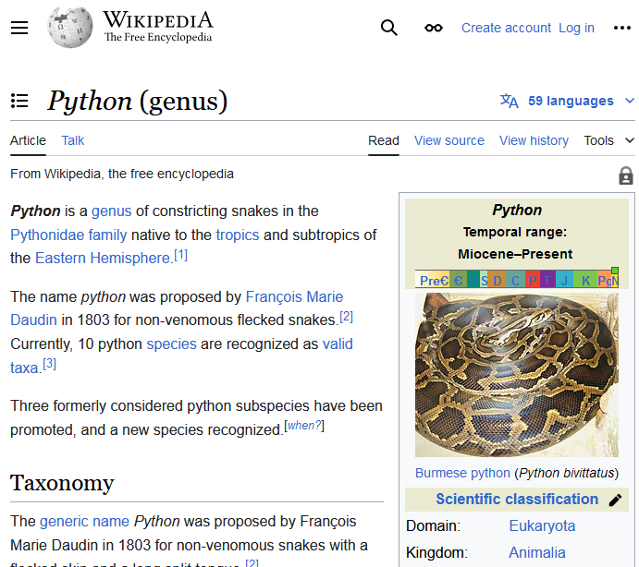
Example:
Question: Who created Python?

Slide 12
Example:
Question: Who created Python?

Slide 13
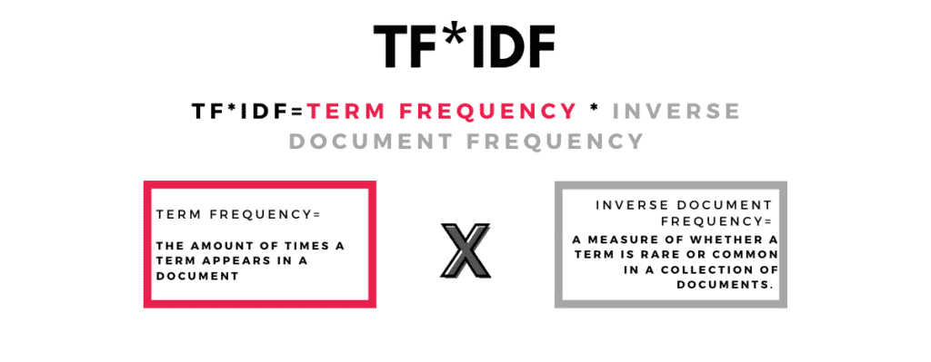
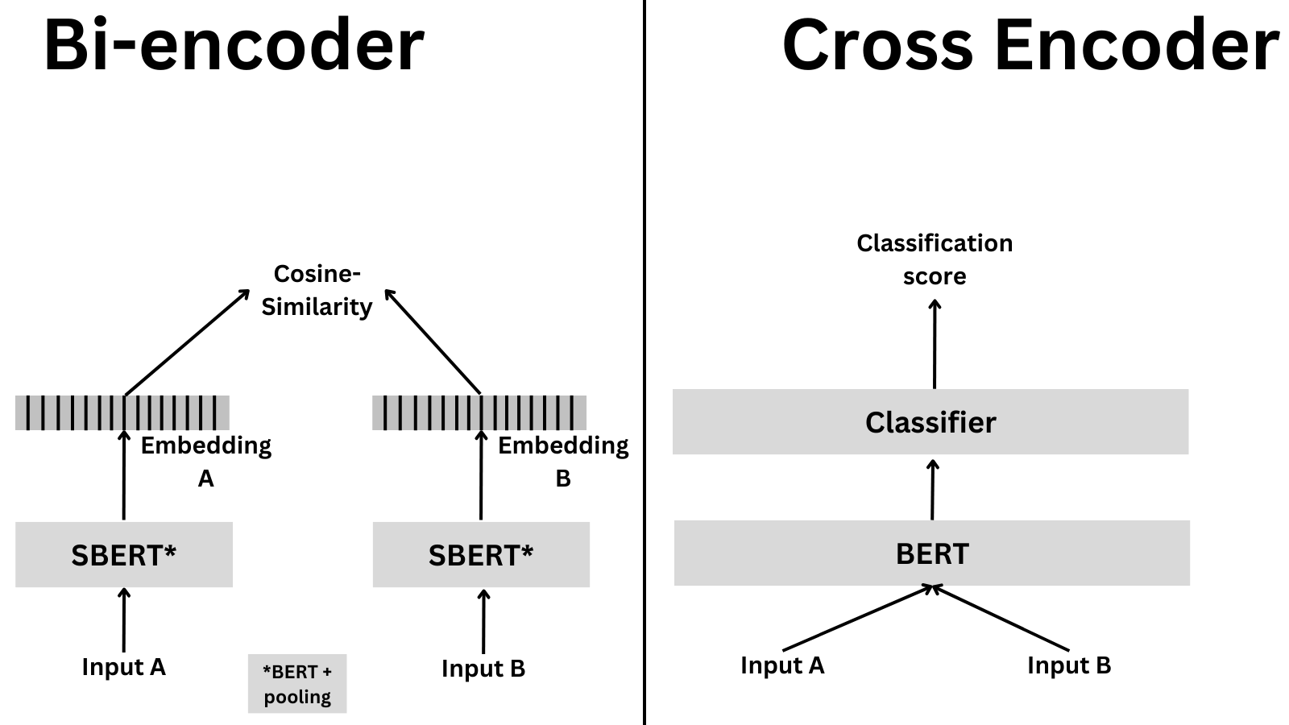
IR Options
Sparse models:
TF-IDF
BM25
Dense Models:
Bi-encoder
Cross Encoder

Slide 14
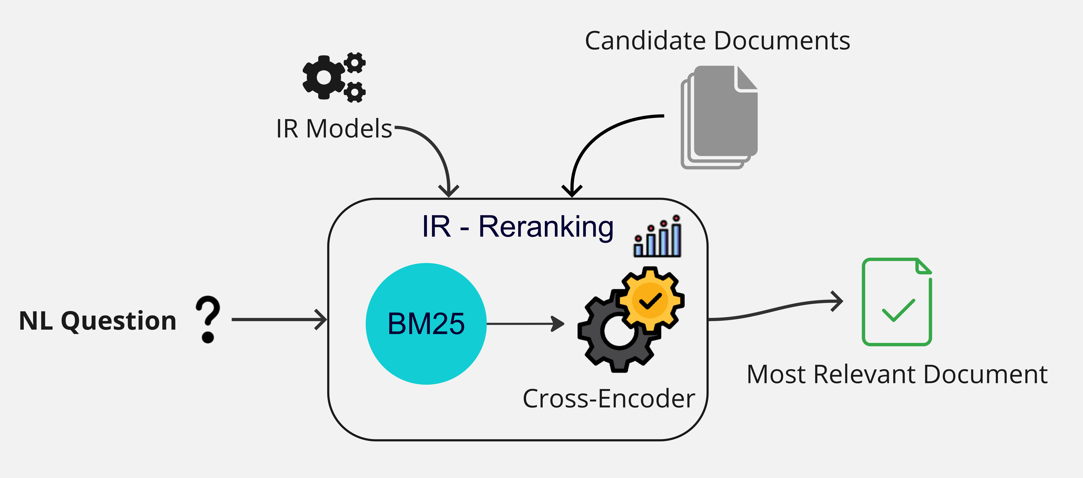
IR Reranking

Slide 15
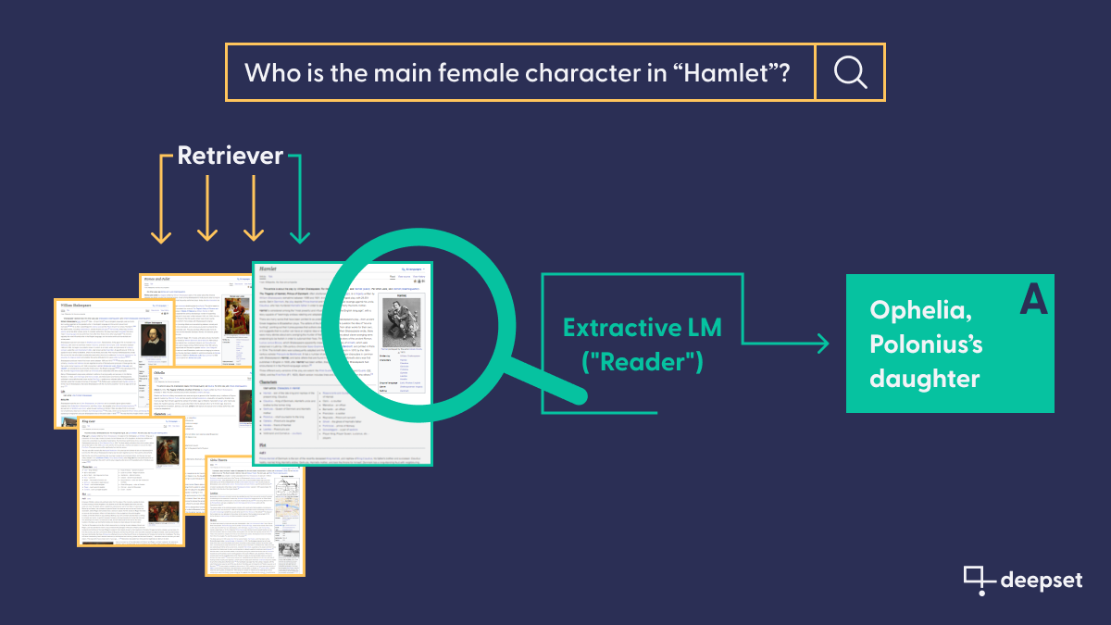
Example

Slide 16
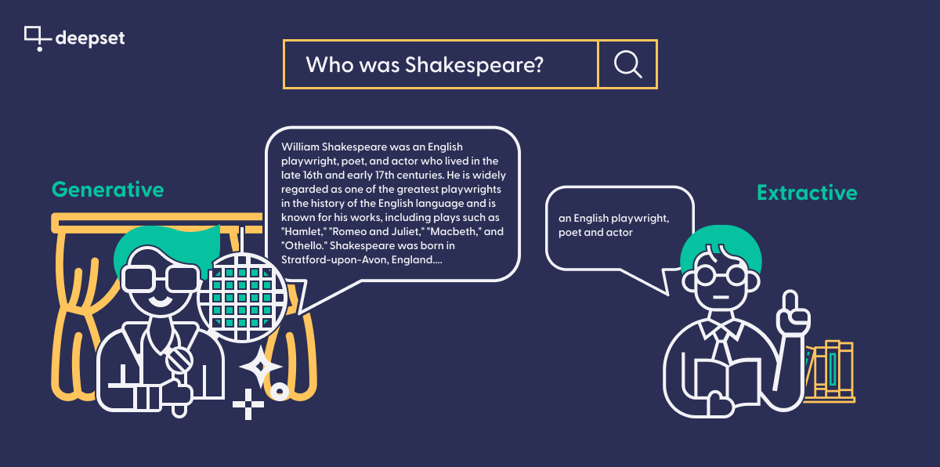
Generative vs Extractive QA

Slide 17
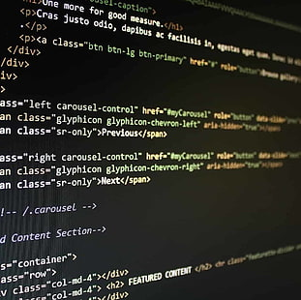
Tutorial
Google Colab environment (sign-in to your google account)
Haystack Library in Python
Build some pipelines
End-to-end Chatbot

Slide 18
Evaluation: IR
Ground-Truth: Questions and Relevant Contexts
Labelled data:
Context Recall
MAP: Mean Average Precision
MRR: Mean Reciprocal Rank
NDCG: Normalized Discounted Cumulative Gain
Unlabelled data:
Context Relevance (LLM based)

Slide 19
Evaluation: QA
Ground-Truth: Questions and Answers
Labelled data:
Exact Match
Partial Match
Semantic Answer Similarity
Unlabelled data:
Faithfulness (LLM based)
Answer Relevance (LLM based)

Slide 20
Question Answering & Information Retrieval
UCREL Summer School. Session 2:
Dr Saad Ezzini and Damith Dola Mullage

